Slide 1
Real-Time Hate Speech Detection in Twitter
Team Members:
JiangLong He, Pavan Varma, Mary Wu, Chen Liao, Kaining Mao

Slide 2

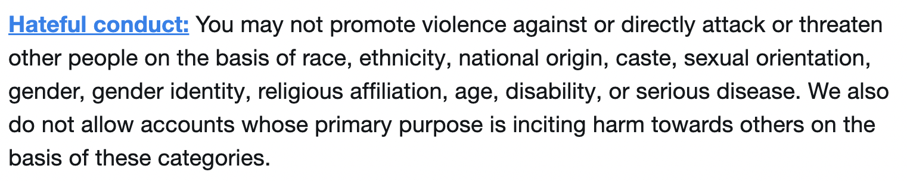
Problem Statement
Social media has become a big part of daily life, with many platforms for users to publicly express their thoughts. As their popularity continues growing these social media platforms are under increased scrutiny to detect and filter out hate speech.
Our project aligns with Twitter’s Hateful Conduct Policy:
*www.dsayce.com
** www.nytimes.com

Slide 3
Problem Statement
We aim to develop an automated system to detect hate speech from Twitter in real-time, which can be used to monitor the platform and flag/remove hateful tweets from Twitter.
Manual flagging is infeasible, based on the statistics:
**statistics of reported hate tweets:
*500 millions tweet per day
1,282 hate tweets reported per day
3,876 hate tweets per day after Elon took over
1 out of 129k tweet are hate speech
Potential manual labor cost:
8hrs shift, 2 tweet/sec, $12/hr
57,600 tweets checked per labor
1736 labors needed to check 100m tweets
$166k per day
*www.dsayce.com
** www.nytimes.com

Slide 4





Why Does This Problem Require Big Data?
Stream 350,000 tweets per minute
Data manipulation, transformation, and model inference at large scale
Data storage of incorrect predictions for model retraining
Data storage of recent tweets for visualizations

Slide 5


Project Phases
Training Phase:
Exploratory data analysis (EDA) to ensure data is usable for model training and to inform our prediction model design
Model training and validation to build the initial model for our pipeline
Production Phase:
Implement the real-time streaming platform

Slide 6
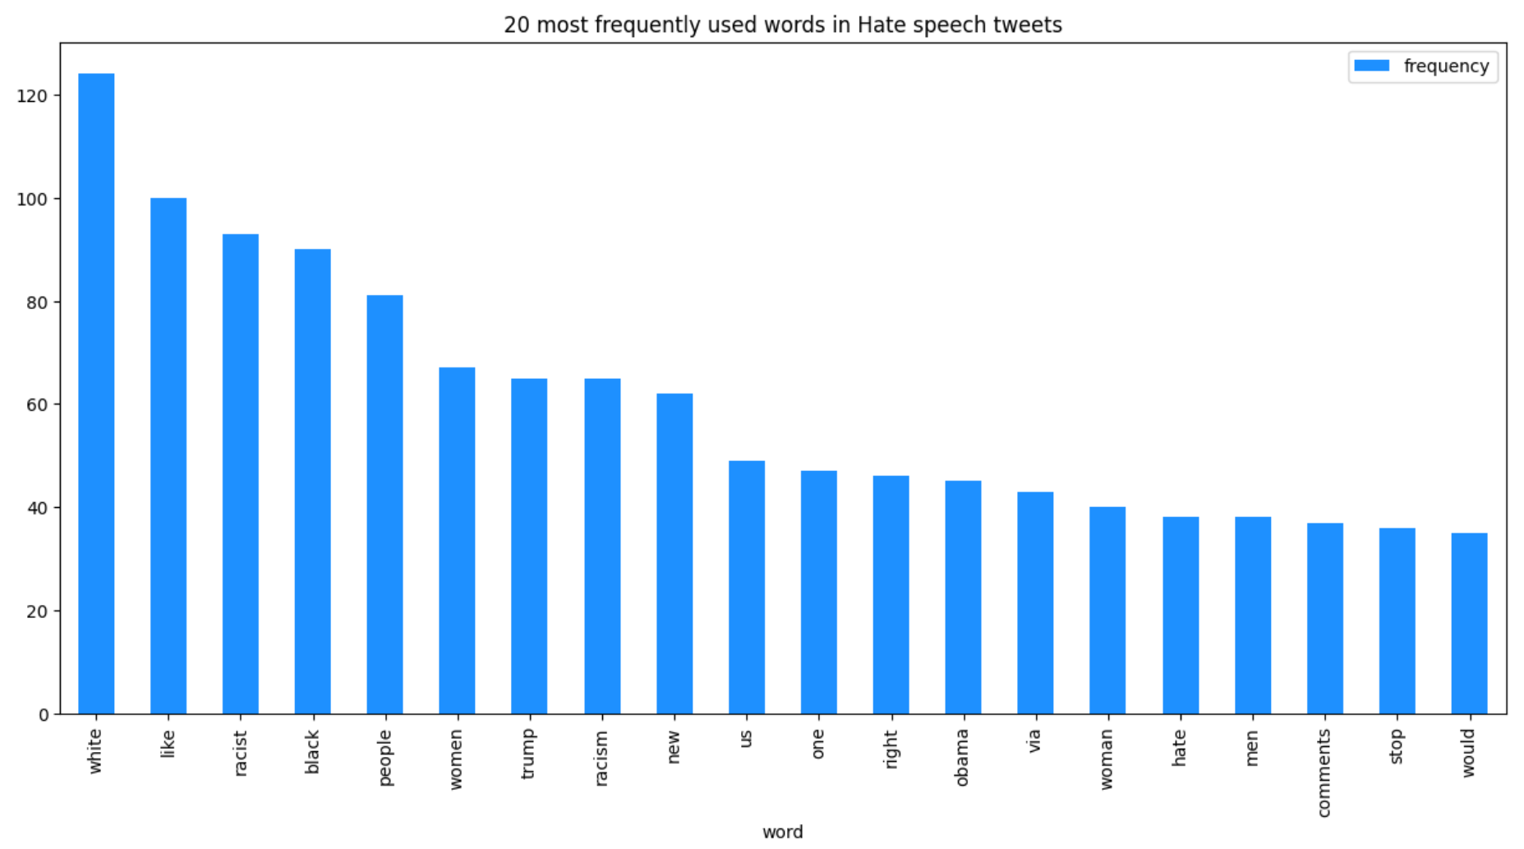
EDA Findings
Class imbalance (7% of tweets were hate speech)
Tweet lengths were normally distributed and within a small range
Different words appeared in hate vs non-hate speech

Slide 7
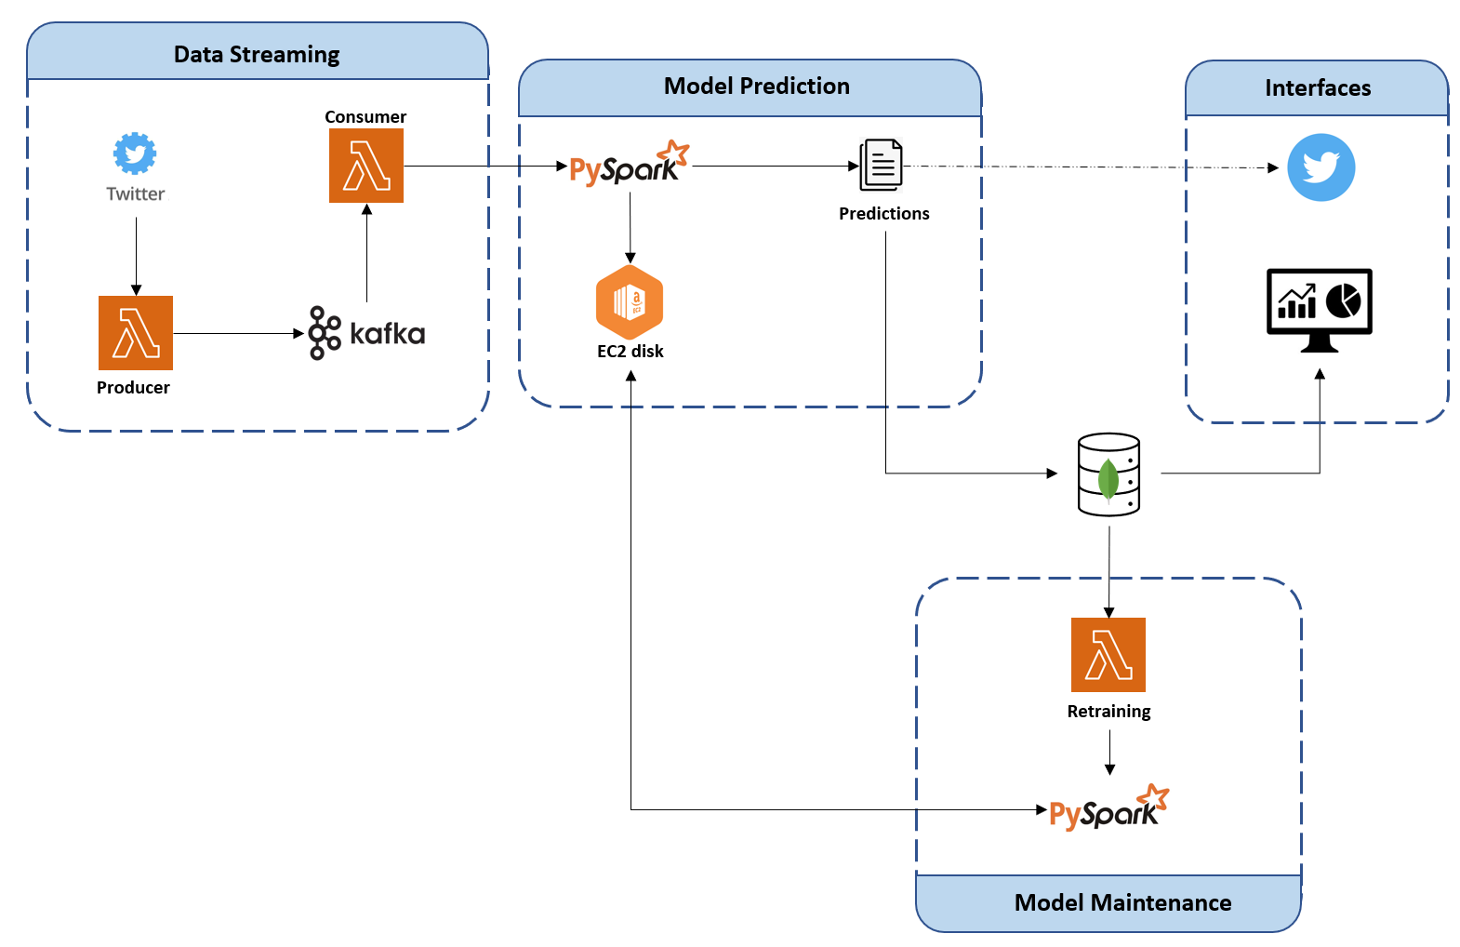
Architecture

Slide 8

Implementation
All the modules are hosted using cloud services:
Apache Kafka cluster is managed by cloudkarafka.
Cluster is configured in 3 brokers, a single topic with 10 partitions is created for twitter streaming data.
MongoDB is provided by mongodb itself as a Service.
AWS EC2 is used as a shared memory for model features storing and also to timely trigger the Producer, Consumer scripts using Cron scheduler.
Mongo Atlas charts are used for visualizing the metrics in real time.

Slide 9
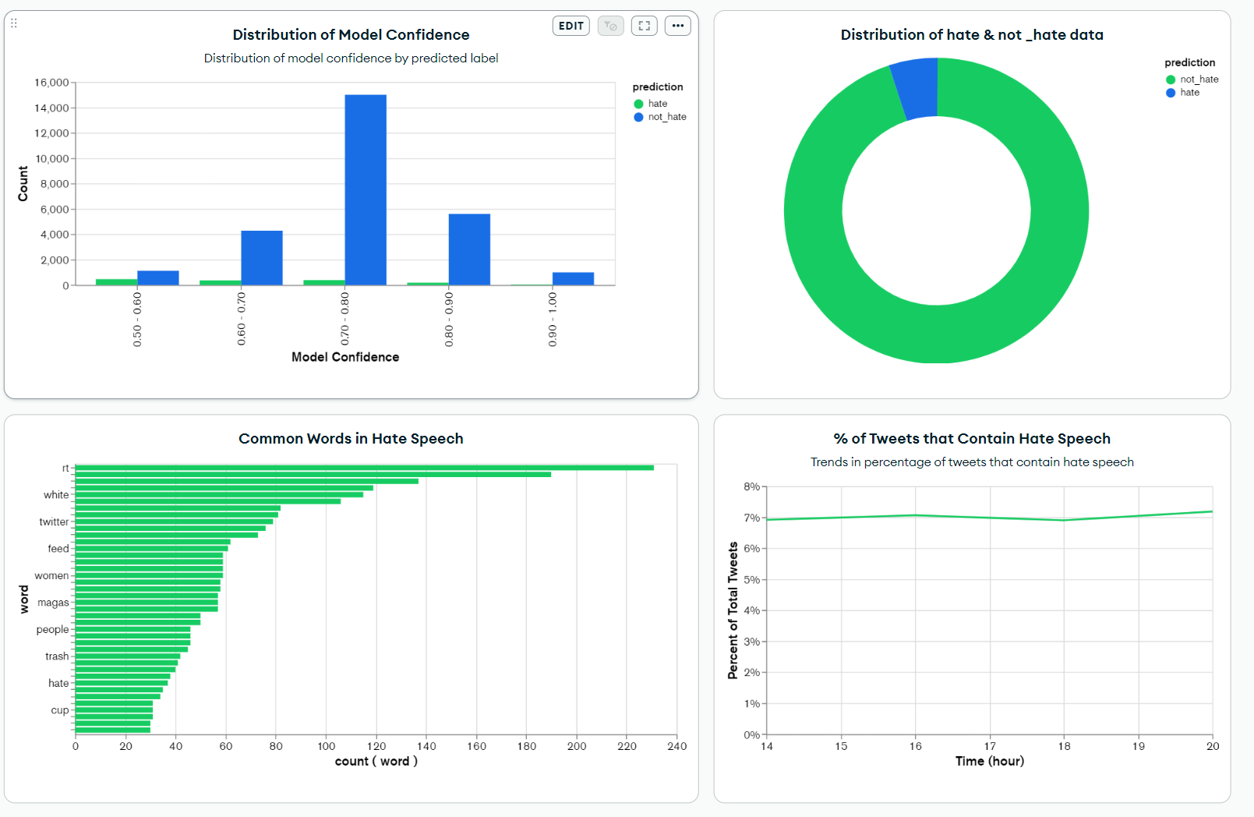
Real Time Visualization

Slide 10
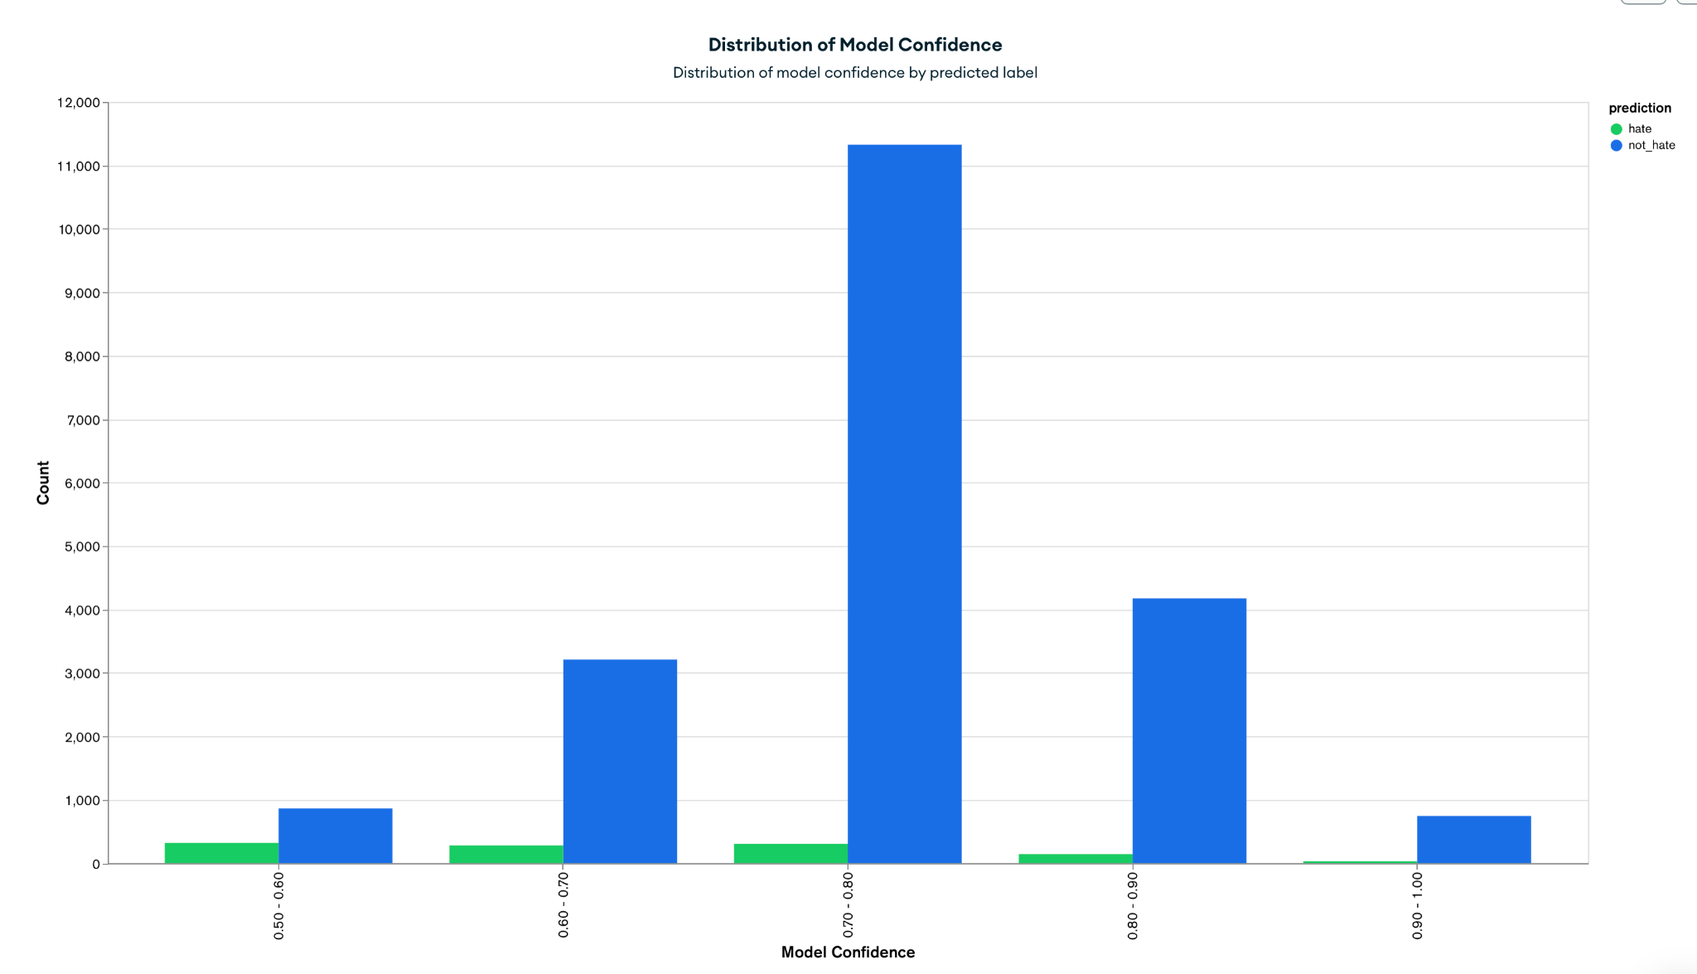
Real Time Visualization

Slide 11
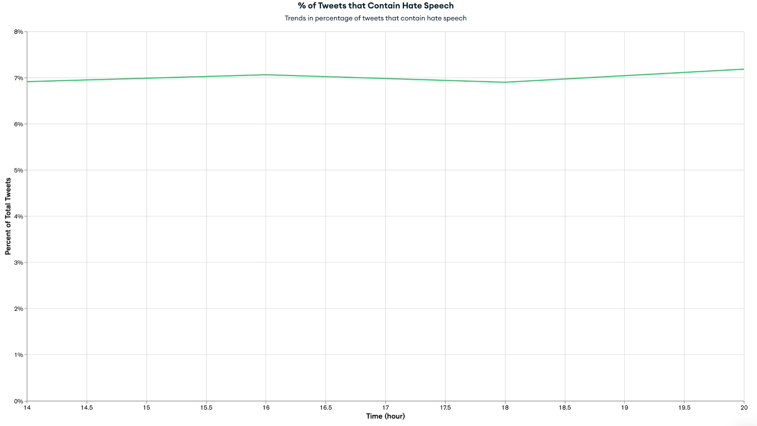
Real Time Visualization

Slide 12
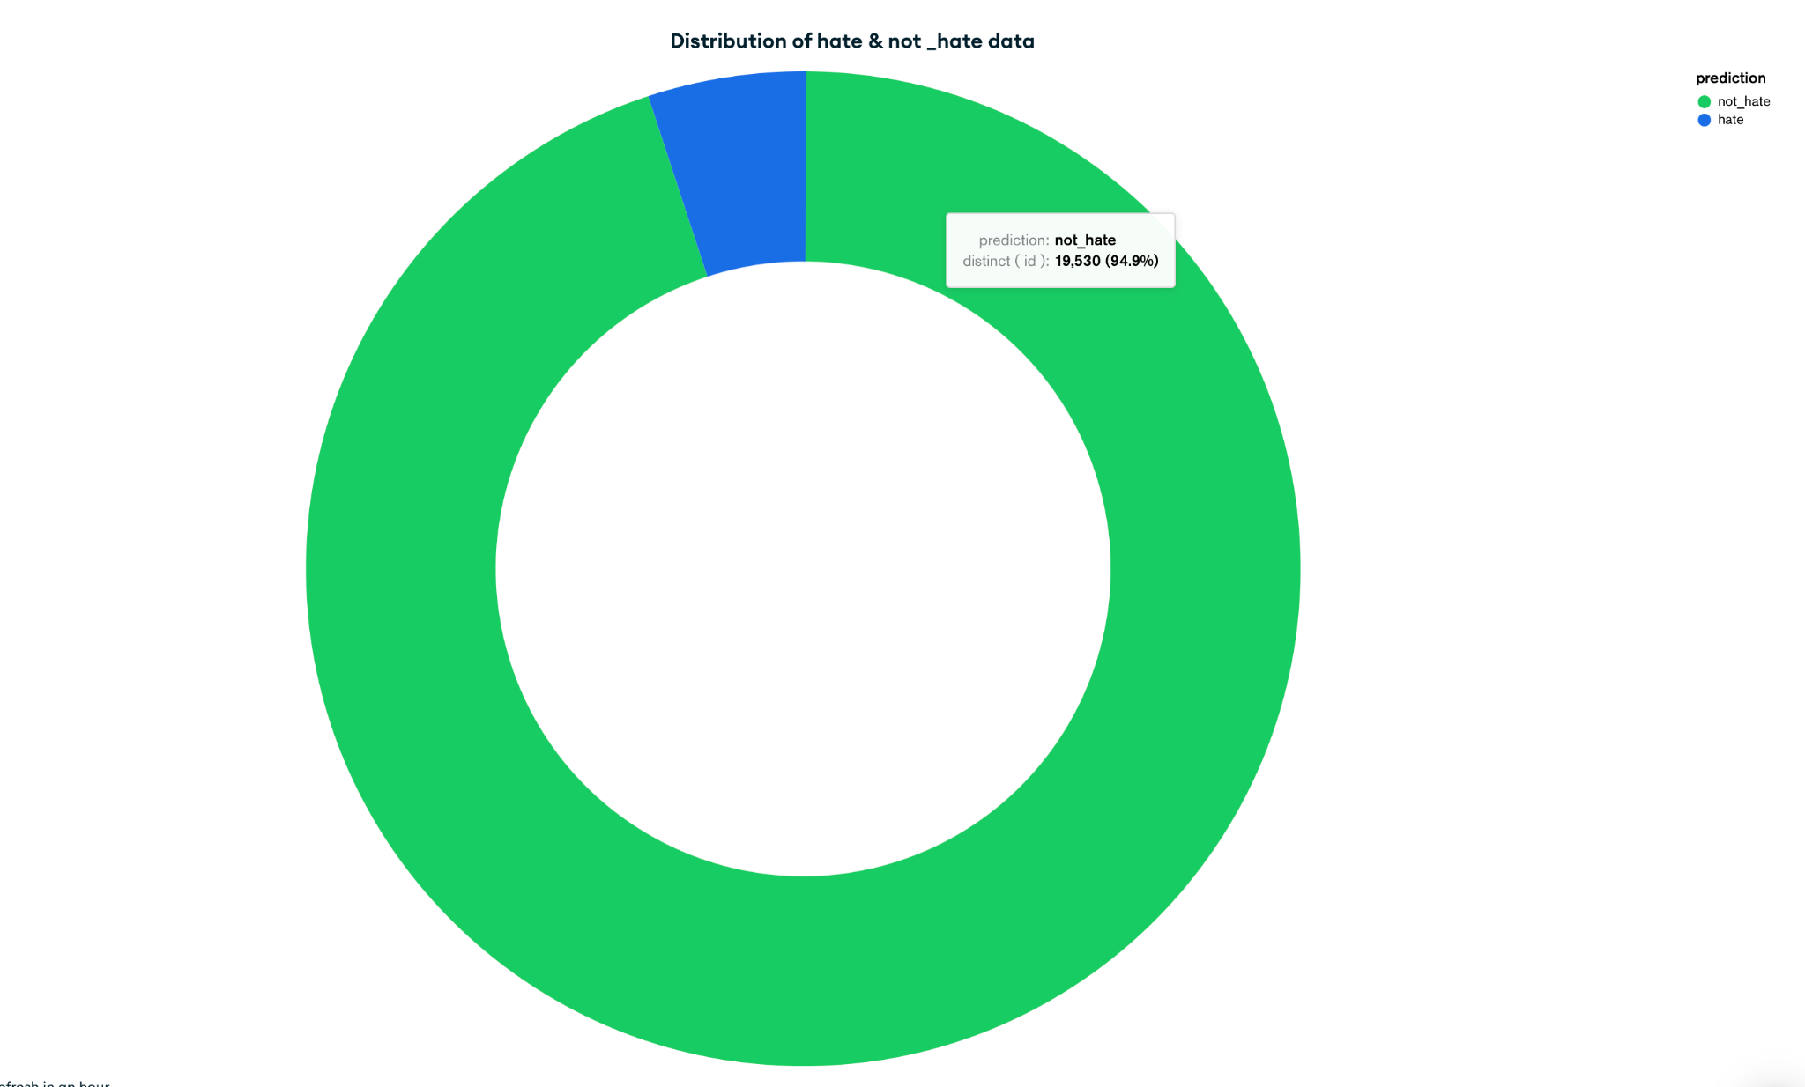
Real Time Visualization

Slide 13
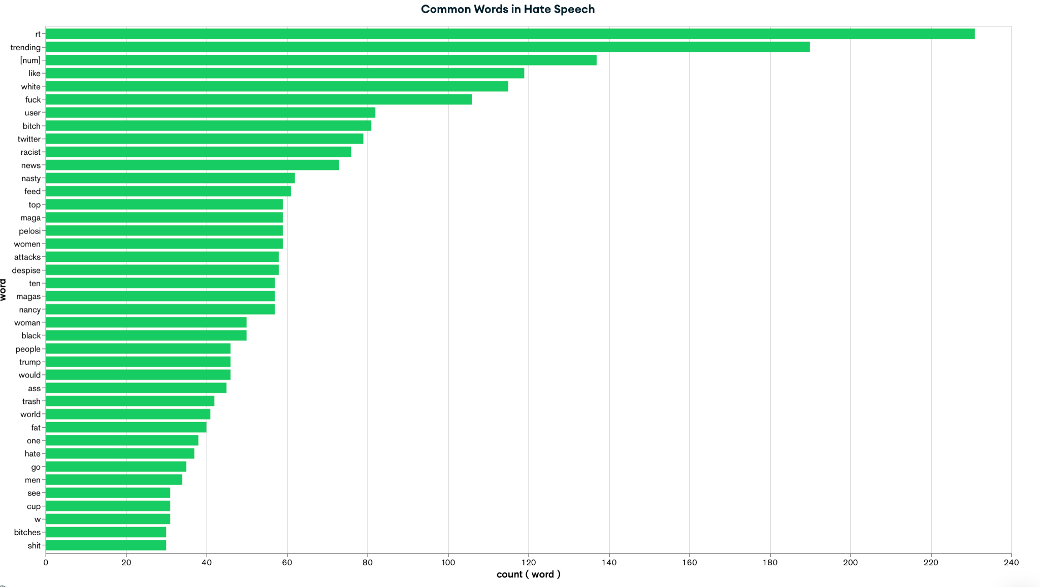
Real Time Visualization

Slide 14
Conclusion
A Quick Recap:
What is hate speech detection?
Why does it require big data?
General architecture & workflow of our system
Visualisation dashboard

Slide 15
Conclusion
Project Deliverable: Designed an end-to-end pipeline to flag hate speech tweets in real-time, designed with big data tools
Big Data Aspects: Streaming data, distributed system, data bulk storage and manipulations
Achievements: Applicable big data system, scalability, modularity, and reliability
Thanks For Your Listening !

